Slide 1
Hydro-DART: Ensemble Streamflow Assimilation with WRF-Hydro and the Data Assimilation Research Testbed
Notes:
This is a collaborative work between DART people in CISL, providing data assimilation capability; and the modeling folks at RAL (Gochis and Mccreight) who support WRF-Hydro

Slide 2




Technical Details: gharamti@ucar.edu
Moha Gharamti
gharamti@ucar.edu
James McCreight
jamesmcc@ucar.edu
These are the researchers! I am the `pit crew’.
Arezoo RafieeiNasab
Arezoo@ucar.edu
Seong Jin Noh
seongjin.noh@gmail.com
The real Ben Johnson
johnsonb@ucar.edu

Slide 3

Outline
WRF-Hydro
A brief overview of ensemble assimilation
Hurricane Florence
DA results from an 80 member experiment
Model bias
Localization
Ensemble spread and Inflation
Gaussian Anamorphosis
Conclusion
3

Slide 4
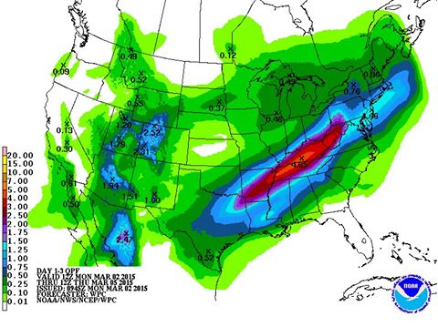
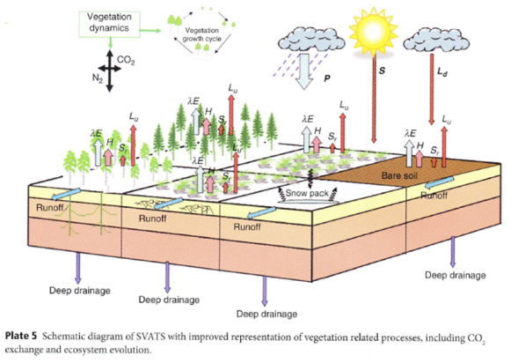
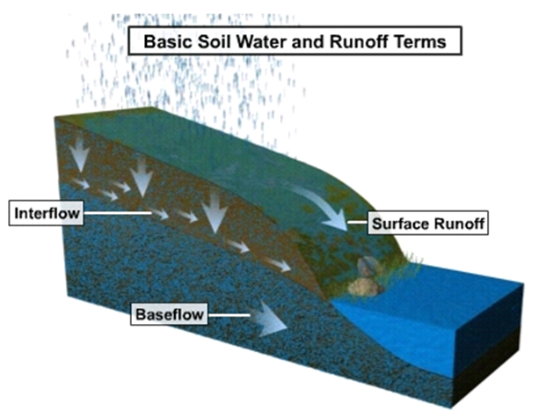
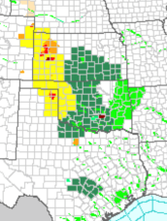
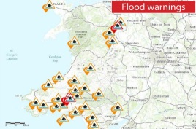
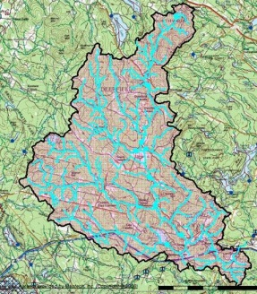
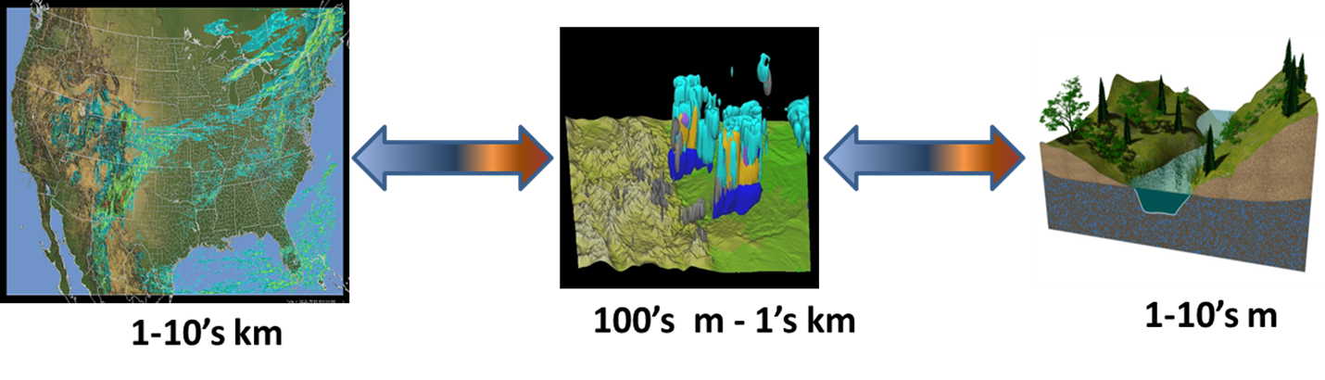
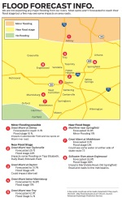
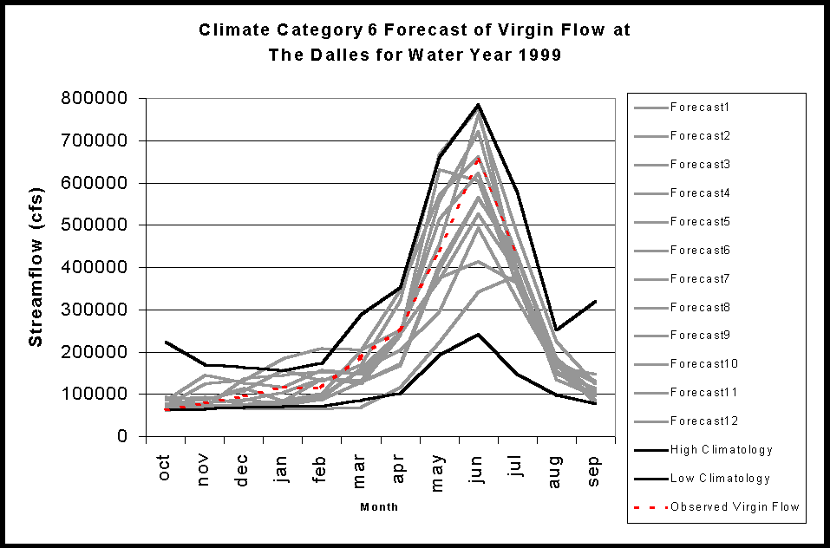
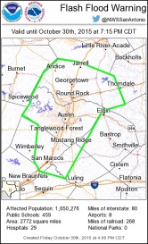
Weather Research & Forecasting Hydrologic Model
Weather Forcing Engine
WRF-Hydro: https://www.ral.ucar.edu/projects/wrf_hydro
NoahMP
Land Surface Model
Terrain Routing Module
2-way coupling
NHDPlus Catchment
Aggregation
Channel & Reservoir
Routing Module
Forecast
Products
Notes:
The core of the National Water Model system is the NCAR-supported community Weather Research and Forecasting Hydrologic model (WRF-Hydro).
Weather Forcing Engine is on a 1km grid.
Land Surface Model is on a 1km grid.
Terrain Routing is on a 250m grid.
National Hydrologic Dataset Plus (NHDPlus) Aggregation results in more than 2.7 million unique catchments and river reaches for the continental United States.
There is no capacity for uncertainty quantification in this configuration – each model has a single deterministic state that ultimately responds to whatever forcing is provided by the single estimate of weather provided by the Weather Forcing Engine.

Slide 5
WRF-Hydro & DART …. HydroDART
Weather Engine
NoahMP LSM
ensembles
ensembles
Python environment
github.com/NCAR/wrf_hydro_py.git
Notes:
Ideally, we would like to have ensembles of all the components, with an ensemble of weather realizations (precipitation, temperature, wind) to faithfully represent the uncertainty of the entire system.
Here, we just focus on the Channel-Only configuration that also has a groundwater bucket contribution. To overcome the limitations of having a single deterministic state, we generate an ensemble of streamflow states for the Channel Module by perturbing a single state with various noise distributions. Then, in the course of an assimilation experiment, it is necessary to sustain some sort of ensemble spread - so we have parametric noise models for both the overland flux and groundwater flux contributions to the Channel Model. The overland flux is intermittent and generally quite small or zero, so the noise is only added for periods when the overland flux is greater than zero. However, since the groundwater flux is uncertain, the noise model is invoked at every step.
The whole thing can be run in docker and comes with a python workflow manager.
The WRF-Hydro team at RAL has configured a test case that encompasses the landfall region of Hurricane Florence

Slide 6

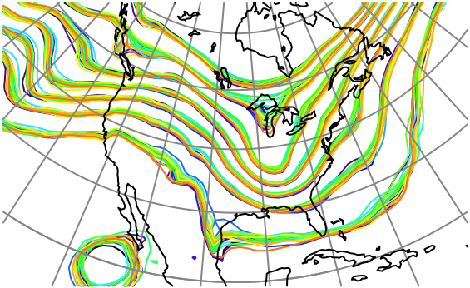
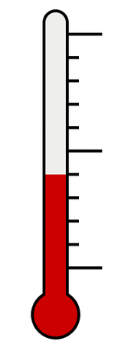

What is Data Assimilation?
Observations combined with a Model forecast…
+
=
… to produce an analysis.
Overview article of the Data Assimilation Research Testbed (DART):
Anderson, Jeffrey, T. Hoar, K. Raeder, H. Liu, N. Collins, R. Torn, A. Arellano, 2009: The Data Assimilation Research Testbed: A Community Facility.
Bull. Amer. Meteor. Soc., 90, 1283–1296. doi:10.1175/2009BAMS2618.1
Notes:
Ensemble DA has been around for almost 20 years now, and the first public release of DART was in 2004. ‘Data Assimilation’ refers to confronting a model state with observations and updating the model state to reflect the information in the observations. The DA algorithm we use in this study is ensemble adjustment Kalman filter.

Slide 7
Ensemble DA in DART
Notes:
We start out with an ensemble of model states that are slightly different – which represents our uncertainty in our knowledge of the state of the system.
The models advance to at time when we have observations.
We estimate what the observation would be from each of the model states and introduce the observation and its uncertainty.
Assimilation is performed with any number of algorithms.
Regression is used to create new model states, the Posteriors.
The whole process is repeated.
A set of model states (ensemble) is integrated forward in time, using WRF-Hydro, and once gauge observations become available, a Kalman (linear)-update step is performed. It is a sequential DA procedure.
In the WRF-Hydro/DART experiments, the forecast cycle is 1 hour.

Slide 8
Hurricane Florence (2018)
Hurricane Florence made landfall near Wrightsville Beach, North Carolina at 7:15 a.m. ET September 14. The GOES East satellite captured this geocolor image at 7:45 a.m. ET
Winds up to 150 mph (240 km/hr)
Damage: $24.23 billion
NOAA/NWS/NCEP/WPC
30+” of rain
Notes:
That little arc of coastline is your reference point for some of the remaining figures. For scale, the straight-line distance from point-to-point is a bit more than 40 miles.
Hurricane Florence was a long-lived Cape Verde hurricane and the wettest tropical cyclone on record in the Carolinas. The sixth named storm, third hurricane, and the first major hurricane of the 2018 Atlantic hurricane season, Florence originated from a strong tropical wave that emerged off the west coast of Africa on August 30, 2018. Florence became a tropical depression near Cape Verde on August 31 and progressed west-northwest, becoming a Tropical Storm on September 1. Florence strengthened rapidly on September 4–5, becoming a Category 4 storm on the Saffir-Simpson wind scale with maximum sustained winds of 130 mph. Florence weakened to a tropical storm by September 7, but the system regained hurricane strength on September 9 and major hurricane status with winds of 140 mph on September 10. However, increasing wind shear caused the storm's winds to gradually weaken over the next few days. However, the storm's wind field continued to grow. By the evening of September 13, Florence had been downgraded to a Category 1 hurricane. Hurricane Florence made landfall near Wrightsville Beach early on Friday September 14, and weakened further as it slowly moved inland.

Slide 9

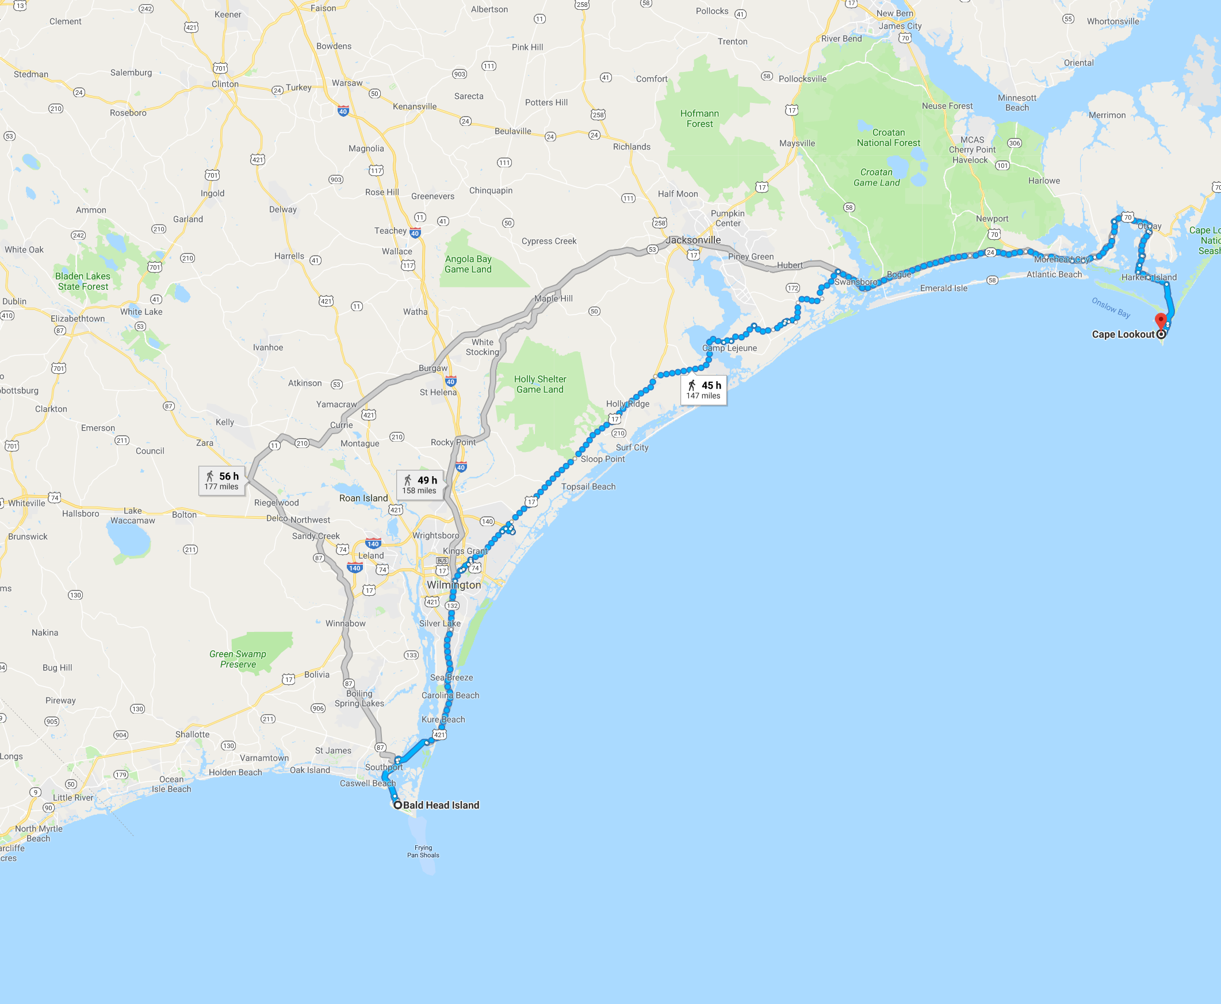


‘scale’ of Florence Domain
About 42 miles
Bald Head Island, NC to Cape Lookout, NC 28531 Walk 147 miles, 45 h

Slide 10
Control: No Assimilation
Monthly mean of the model. The streamflow is driven by the precipitation.
More than 100 gauges, reporting every 15 mins.
Now, what happens when streamflow gauge data is incorporated through DA?
cms is m³/s
cms is m³/s
Notes:
We use an 80 member ensemble. Unstructured grid with more than 50,000 links.
Streamflow data available at more than 100 gauges every 15 mins. Gauge locations is given in black circles.
We run an open loop; i.e., 80 member ensemble forward in time with no assimilation of data. The goal is to assess the performance of the model, detect biases, … This is later compared to a DA run, that uses adaptive inflation (both in space and time), a new pattern-based localization and Gaussian Anamorphosis (variable transform).
Prior to this, we spin up the entire 80 members (with perturbed forcings) for around a month.
What you see in figure is the time-averaged ensemble mean over the simulation period (9/7 – 10/7), obtained using the control configuration. Line thickness and color represent flow.

Slide 11
Data Assimilation Impact
Assimilation happens every hour
Correction along major reaches. DA is adding water to the stream channels.
Newport River
Upstream
Ashley River
Downstream
Cooper River
720 hourly assimilation cycles
Wando River
Cape Fear River
Notes:
Difference between posterior mean (DA) and Control. On average, DA seems to add water to the channels suggesting that the model underestimates the streamflow compared to the observations.
Major update happens along the main stream channels.
I’m going to focus on the two gauges highlighted here.

Slide 12
Upstream Gauge
STREAM_FLOW_066453 | Gauge ID: 2131000
Posterior members
Posterior mean
Prior members
Gauge Observations
Prior mean
Large improvements to the amplitude and the phase compared to the control
Control
Notes:
The CONTROL is biased low relative to the observations and the timing does not match.
The model seems to peak too early.
Note how the posterior mean is much closer to the assimilated observations.
The real actionable information here is on the rising limbs – the assimilation is much more accurate.
All the observations here are used, thanks to inflation (will be shown later).

Slide 13
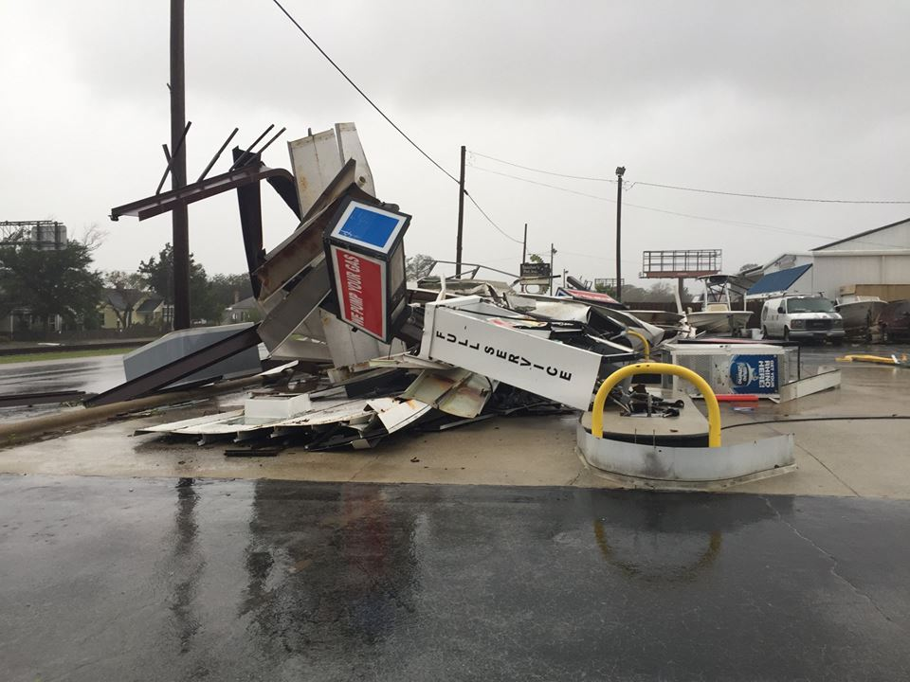
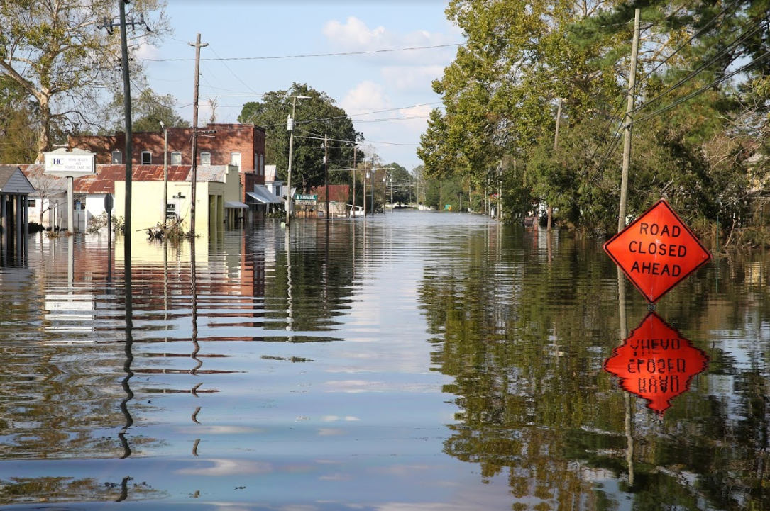
Downstream Gauge
Prior greatly improves the model’s estimate
Difference between knowing what to do (like evacuating people) and not doing anything!
Posteriors provide almost a perfect match with the gauge streamflow data
Notes:
Here is the downstream gauge – here 12% of the observations are rejected. This happens before the flood when the flow is very small. The open loop is very biased compared to the observations. The open loop also shows a small event (around Sep 12). This event is not reflected in the observations.
The prior spread increases to cover the observations, strongly reducing the bias in the model. The posterior comes very close to the observations. Notice how the prior spread gets constrained after assimilating the streamflow. The improvements suggested by the DA system here are very important.
The use of pattern-based localization is quite important. The results strongly degrade when localization is not used.

Slide 14
Improvements: control->prior->posterior
Taylor Diagram
NEITHER
Control
ACCURATE,
NO PRECISION
BEST
Notes:
This is a standard diagram called a Taylor diagram.
You can see that all of the gauges exhibit improvement.
A higher correlation coefficient, lower centered rmse and target standard deviation

Slide 15
Significant Technical Enhancements
Inflation: As a way to increase ensemble uncertainty, adaptive both in space and time
Pattern-based (Along-the-stream) localization: To minimize sampling errors
Gaussian Anamorphosis: Variable transform to accommodate positive definite variables (with non-Gaussian distributions)
Notes:
Details included in the notes on the next 3 slides.

Slide 16
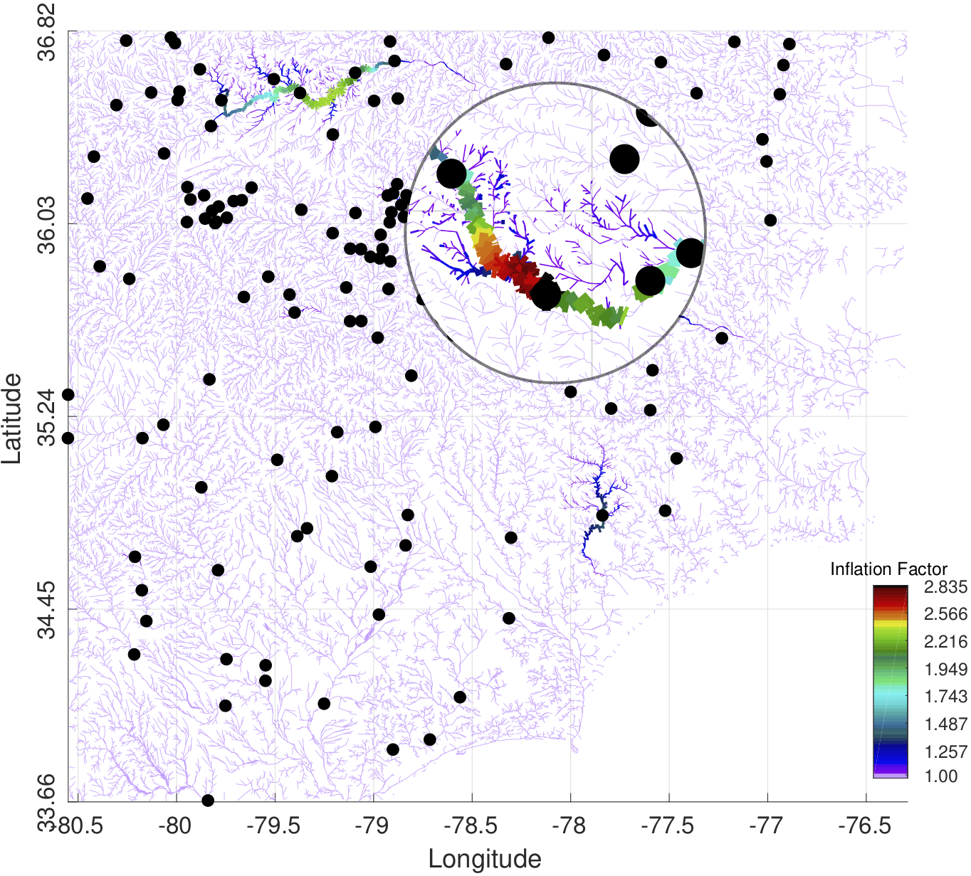
Adaptive Inflation
Inflation aims at making the model consistent with observations
Ensemble and observations are consistent
Notes:
Big discrepancies between the model and the observations cause the filter to impose large corrections on the prior ensemble. Large corrections may strongly decrease the spread in the ensemble and can eventually lead to ensemble collapse. If ensemble collapse happens, the filter would longer be able to utilize the observations. Inflation is a way to inject variability in the ensemble, by inflating the members around the mean (without actually changing the mean). The inflation scheme we use here is both spatially and temporally varying (El Gharamti, 2018).
As can be seen in the figure, inflation is larger than one in the northern part suggesting that there might be a mismatch between the model and the observations.

Slide 17
Florence Domain: localization
Localization occurs along the reaches, not just based on horizontal distance. Upstream & Downstream.
100 km localization distance is used
Notes:
One of the more interesting DA aspects is the localization – in this context watersheds are more logical than simple geographic distance. We are using a gaspari-cohn window based on the along-stream distance. For visualization purposes, we used a half-width of 100km.

Slide 18
Gaussian Anamorphosis Capability
Control,
Observation rejection is improved with GA.
Better fit to the observations on Sep. 17th.
Higher order moments are almost completely eliminated using GA.
Control,
Notes:
Streamflow is a positive quantity. Negative flow is not physical. The Kalman update does not respect this positiveness constraint. Hence, the distributions are not Gaussian.
GA aims at transforming the variables into Gaussian space before performing the update. The update happens in a Gaussian space (which fits the context of the KF), and then an inverse transform to the physical space is performed.
The transformation can be analytical (e.g., logarithm) or fully empirical by projecting the ensemble into standard normal distributions. This is done by constructing the inverse cdf of the ensemble and then finding its quantiles. A piece-wise linear function is then constructed using these quantiles and interpolation is used to find a smooth function.

Slide 19
Conclusion
We use DART to perform streamflow and flood prediction with WRF-Hydro (NWM) during Hurricane Florence.
DART greatly improved the streamflow estimates
Novel enhancements to the DA algorithm were required:
- Using pattern-based localization
- Spatially and temporally varying inflation
- Gaussian anamorphosis
Next Steps: Update soil moisture, groundwater and ice; force the coupled system with an ensemble of atmospheric forcing, …

Slide 20


For more information:
GCOM
CAM-Chem
FESOM
ROMS
CAM
WRF
GITM
CABLE
WRF-Hydro
WACCM
CLM
POP
AM2
BGRID
SQG
https://dart.ucar.edu
dart@ucar.edu
COAMPS
NOAH
NCOMMAS
PE2LYR
MITgcm_ocean
WRF-Chem
COAMPS_nest
NAAPS
TIEGCM
MPAS_ATM
MPAS_OCN
PBL_1d
WACCM-X
NOAH-MP
We would like to acknowledge high-performance computing support from Cheyenne (doi:10.5065/D6RX99HX) provided by NCAR's Computational and Information Systems Laboratory, sponsored by the National Science Foundation.
20

Slide 21
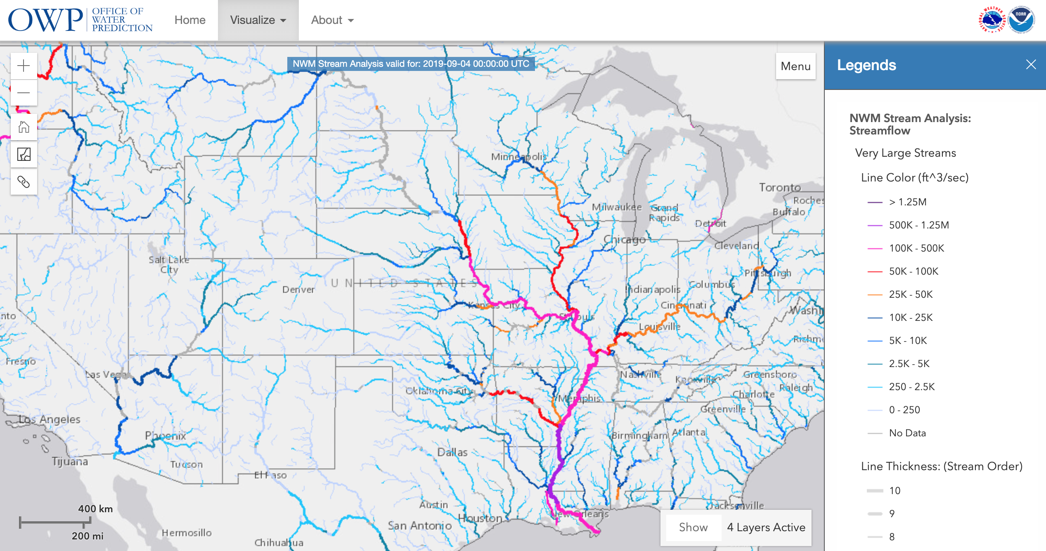
NATIONAL WATER MODEL (NWM)
https://water.noaa.gov/about/nwm
Notes:
The National Water Model (NWM) is a hydrologic modelling framework that simulates observed and forecast streamflow over the entire continental United States (CONUS). The NWM simulates the water cycle with mathematical representations of the different processes and how they fit together.
The image, retrieved from the NOAA website, shows the streamflow distribution over CONUS on Sep. 4th at midnight.

Slide 22
Topography of North Carolina
Moore, et al. Southeastern Geology 51(4):145- 171, March 2016

Slide 23
Dorian (aside)

Slide 24
Gaussian -> NonGaussian positive
From: Penn State Stats 400 level online course.

